Slide 1
Chapter 2

Slide 2
Encryption

Slide 3
BRIEF HISTORY OF ENCRYPTION
Early code attempts used transposition. They simply rearranged the order of the letters in a message. Of course, this rearrangement had to follow some order, or the recipient would not be able to restore the message.
Other early attempts at cryptography (the science of data protection via encryption) used substitution.
A substitution algorithm simply replaces each character in a message with another character.

Slide 4
Caesar’s cipher is an example of a substitution algorithm. To create these messages, you list the alphabet across a page and agree with the recipient on the starting letter—suppose you agree to start with the fourth letter of the alphabet, D.
Starting with this letter, you write down a new alphabet under the old, so it looks like this:

Slide 5
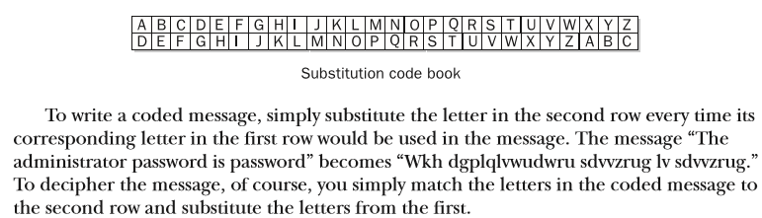

Slide 6
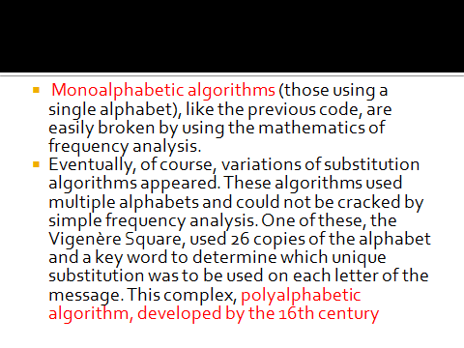

Slide 7
Public Key Cryptography
This algorithm is asymmetric—it uses a set of related keys. If one key is used to encrypt the message, the other is used to decrypt it, and vice versa.
This means that if each party holds one of the keys, a session key can be securely exchanged. In the typical arrangement, each party has their own set of these asymmetric keys.
One of the key pairs is known as the private key and the other as the public key. Public keys are exchanged and private keys are kept secret. Even if a public key becomes, well, public, it does not compromise the system. It’s meant to be shared openly.

Slide 8
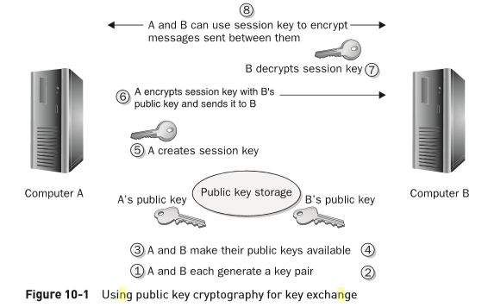

Slide 9
Key Exchange:
Public/private key pairs can be used to exchange session keys. To do so, each party that needs to exchange keys generates a key pair.
The public keys are either exchanged among the parties or kept in a database. The private keys are kept secret. When it is necessary to exchange a key, one party can encrypt it using the public key of the other.
The encrypted key is then transmitted to the other party. Since only the intended recipient holds the private key that is related to the public key used to encrypt the session key, only that party can decrypt the session key.
The confidentiality of the session key is assured, and it can then be used to encrypt communications between the two parties.

Slide 10
Public Key Infrastructure
Public Key Infrastructure (PKI) has become one of the most prevalent forms of encryption in modern electronic transactions.
An associated key pair is bound to a security principal (user or computer) by a certificate.
The certificate also makes the security principal’s public key available, while the related private key is kept hidden.
A certificate authority (CA) issues, catalogs, renews, and revokes certificates under the management of a policy and administrative control. There is no need either to purchase third-party products to do so, or to purchase individual certificates from public CAs.

Slide 11
CA Hierarchy
In a hierarchy, one root CA provides CA certificates for another level of CAs. While there are many hierarchical designs that can be arranged, the classic, best practice design is displayed in Figure 10-2. In this design, the root CA is kept offline and produces CA certificates only for the next, intermediary level of CAs. These CAs are integrated with AD and kept online. They issue certificates for a third level: the issuing CAs that actually issue certificates for end use such as EFS or smart cards. Issuing CAs do not issue CA certificates.

Slide 12
